Slide 1

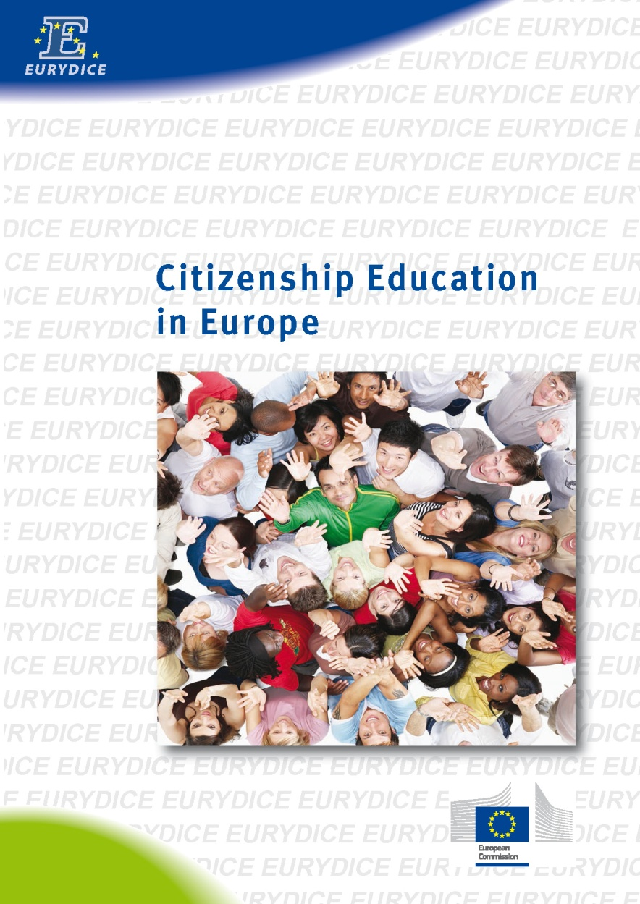
ADD PHOTO HERE
and replace this box
Citizenship education in Europe
Main findings from the Eurydice report
Ana Sofia de Almeida Coutinho
Eurydice and Policy support unit - EACEA
Conference 'Social and citizen's responsibility'
Slovenia - 10 October 2013
Education
and Training

Slide 2
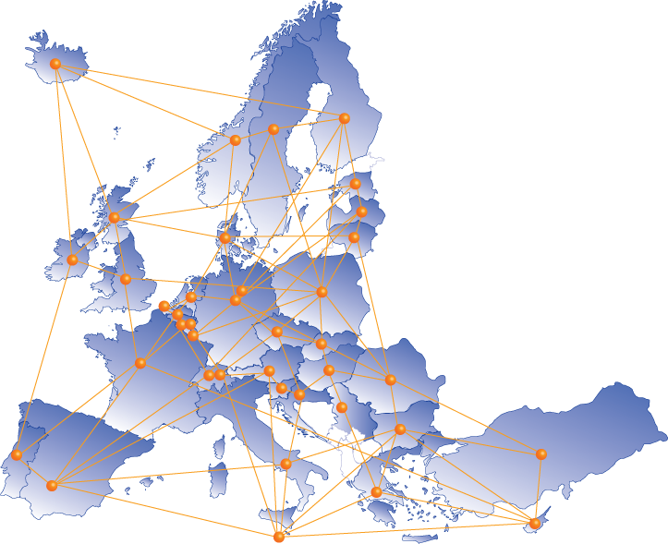
The Eurydice network
36 countries = 40 National Units
One coordinating unit =
Eurydice and Policy Unit at EACEA

Slide 3
Citizenship education in
European and international context
Social and civic competences
Charter on Education for Democratic Citizenship and Human Rights Education (Council of Europe)
2009 IEA International Civic and Citizenship Education Study (ICCS)

Slide 4
Definition, scope and methodology
Broad concept
2010/11
Primary and secondary level
31 countries covered
Eurydice questionnaires
2009 ICCS data

Slide 5
Citizenship education in Europe
Curriculum:
  Approaches, taught time and assessment
Informal learning
  School culture, out-of-school activities and school governance

Slide 6
Status in the curriculum
Feature in all countries curricula
Three main approaches, often combined:
Integrated in other subject
Separate subject
Cross-curricular

Slide 7



Cross-curricular approach
ISCED 1, 2 and 3
Elements of citizenship education are included:
in cross-curricular themes, key competences, learning content areas
only as general objectives
of the education system
data not available
Source: Eurydice.

Slide 8

Separate and compulsory subject
ISCED 1, 2 and 3
Separate subject at primary level
Separate subject at secondary level
Not a separate subject at
either primary or secondary level
data not available
Source: Eurydice.

Slide 9


Taught time
Average minimum taught time devoted to citizenship education as a separate subject
during a notional year, ISCED 1, 2 and 3, 2010/11
Hours
Hours
ISCED 1
ISCED 2
ISCED 3
Source: Eurydice.

Slide 10
Contribution of marks on the transition to the next level
Marks in separate subject - ISCED 2 or
full-time compulsory education
always taken into account
not systematically
taken into account
never taken into account
not taught as a separate compulsory
subject or single structure compulsory education with no transition
data not available
Source: Eurydice.

Slide 11
Informal learning
School culture
Out-of-school activities
  Curriculum and steering documents
  Nation-wide programmes and projects
  → Great variation of 8th grade student's participation in civic-related activities in Europe (2009 ICCS)

Slide 12
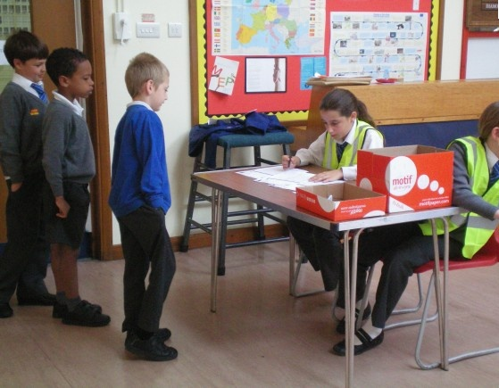
School governance
Regulations in all countries:
→ Right for students to participate in school-life
and decision-making

Slide 13
Students' participation
  Class representatives
  Students' councils
  School governing bodies
Decision-making
Consultative
Informative

Slide 14

Assessing student's participation
Central guidelines on assessing students’ active participation in school or in the community
ISCED 2 and 3, 2010/11
Central guidelines
No central guidelines
data not available
Source: Eurydice.

Slide 15
Conclusions
Citizenship education feature in all countries' national curricula
Informal ways of learning are widely promoted
Challenges / questions

Slide 16
Students'participation in school elections

Slide 17
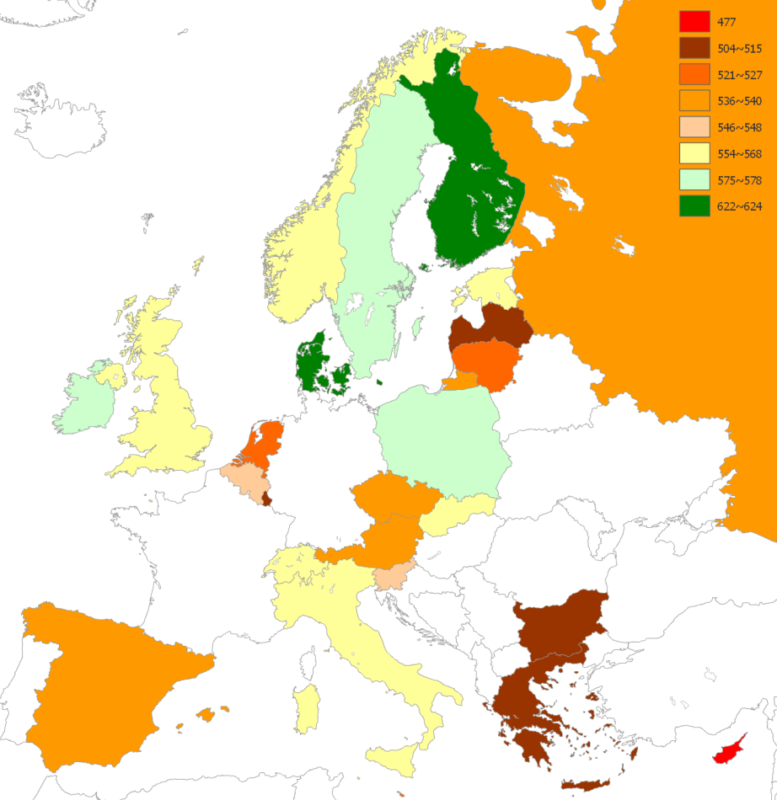
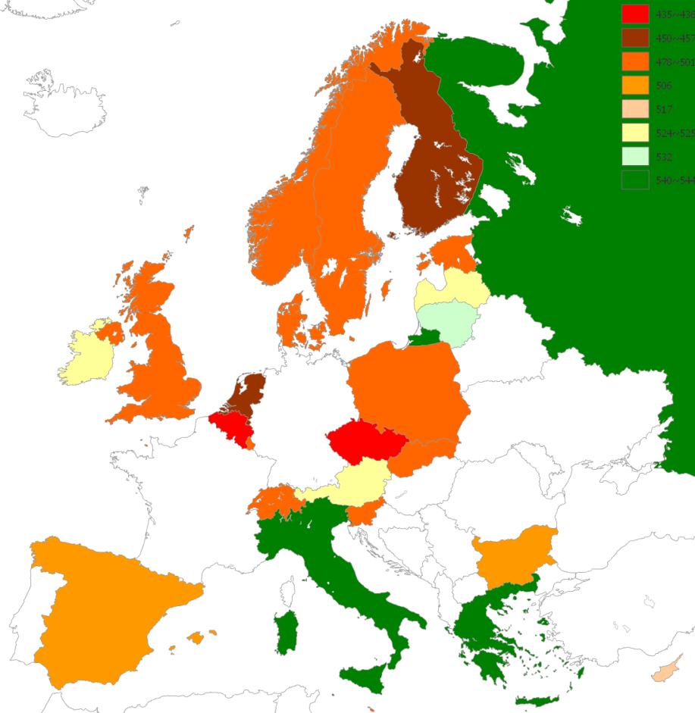
Civic competences of young Europeans, ICCS 2009
Knowledge and Skills on Democracy
Participatory Attitudes in Europe
Source data: CRELL, 2009

Slide 18
Thank you for your attention.
For more information:
Eurydice website
http://eacea.ec.europa.eu/education/eurydice/

Slide 19
Content
OBJECTIVES
Political literacy
Critical thinking
Values, attitudes: tolerance, solidarity
Active participation and engagement
Civic-related skills
Social skills
Communication skills
Intercultural skills
SKILLS
Political system
Human rights
European identity
International relations
KNOWLEDGE AND UNDERSTANDING

